Slide 1
Wolf Restoration & Management Plan
Public Outreach &
Advisory Group Facilitation
Keystone Policy Center
Meet & Greet with Parks and Wildlife Commission
May 6, 2021

Slide 2
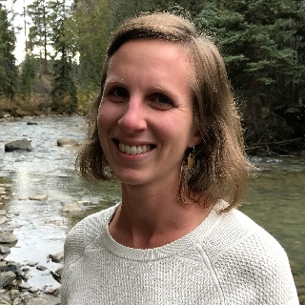
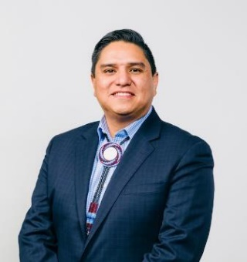
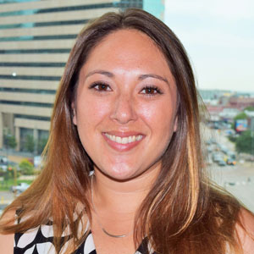
Core Team Introductions
Julie Shapiro
Director, Natural Resources
Team Lead
TWG Lead; SAG Co-Lead
Ernest House, Jr.
Director, AI/AN
SAG Co-Lead,
West Slope, Tribal and Indigenous Outreach
Cally King Newman
Sr. Project Manager
Public Involvement Lead
TWG and SAG Support
Notes:
(Core team intros and roles)
In addition to this core team, we offer a deep bench of experienced natural resources facilitators and support staff, enabling us to easily scale up for public meetings and to leverage relationships, process design frameworks and learnings from related contentious facilitation efforts throughout Colorado.

Slide 3
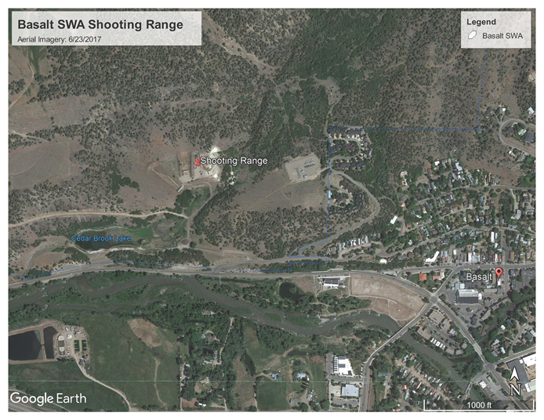
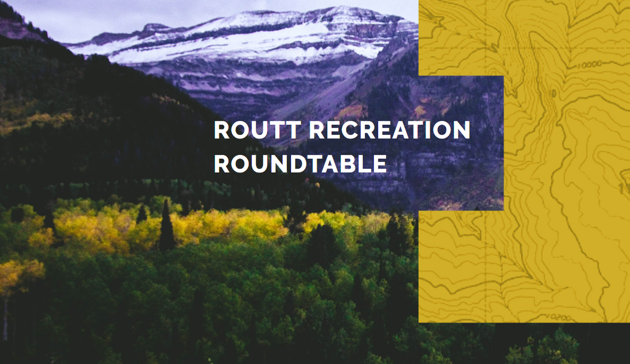

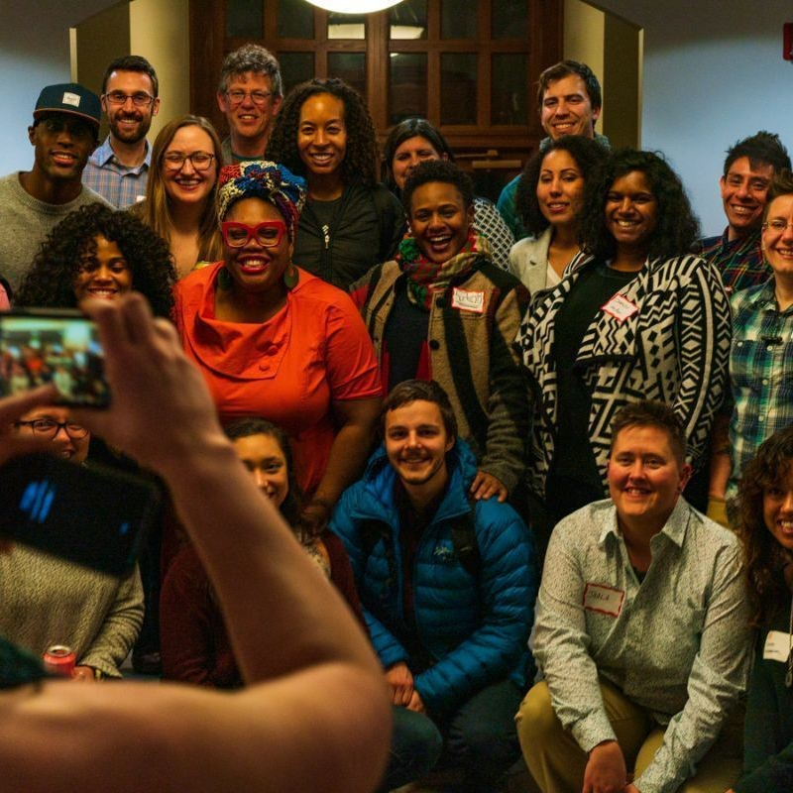

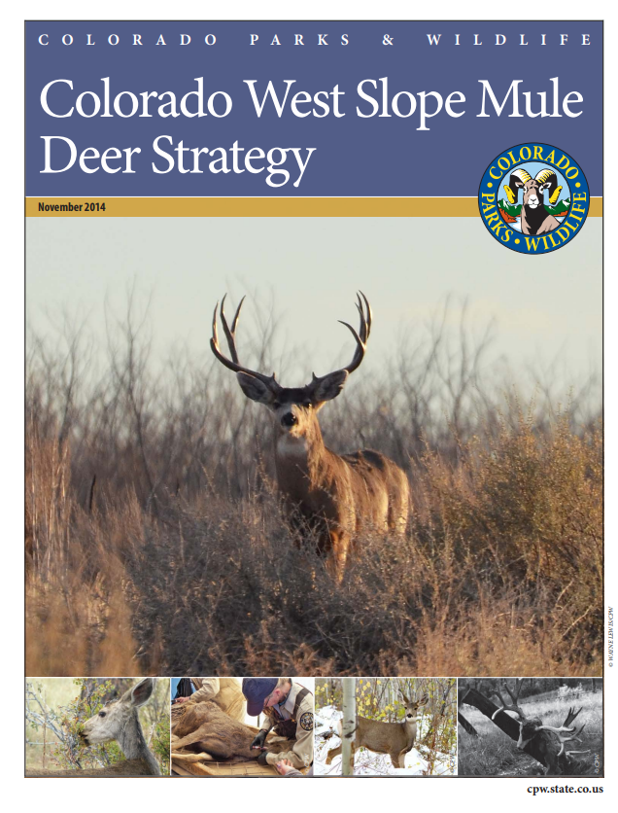
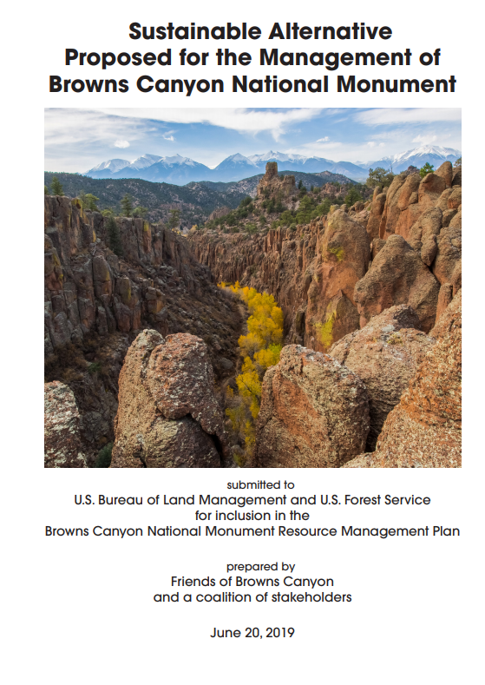
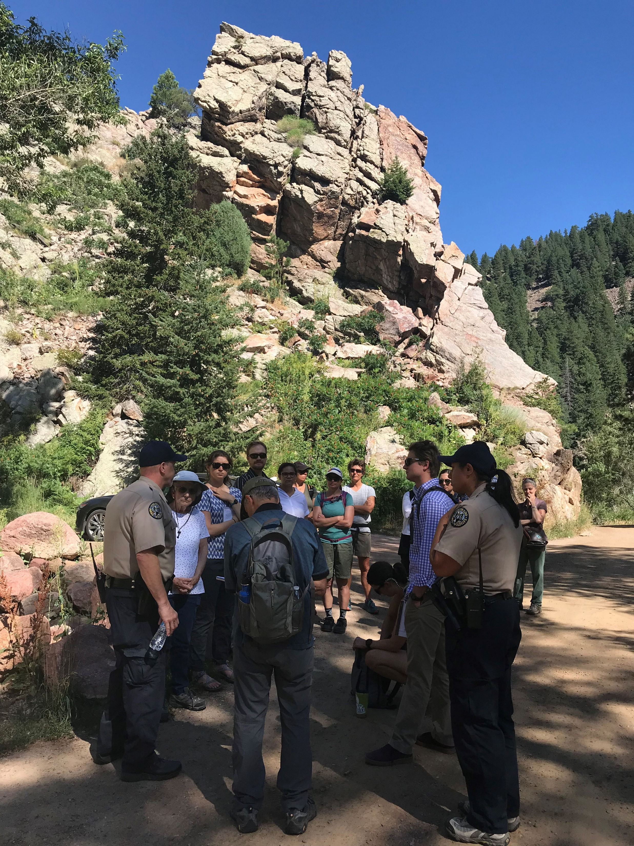

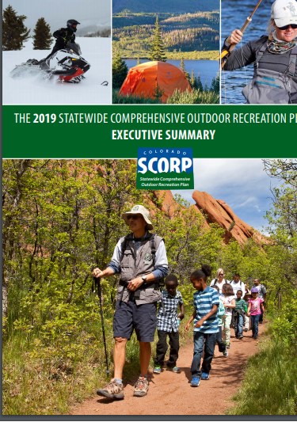
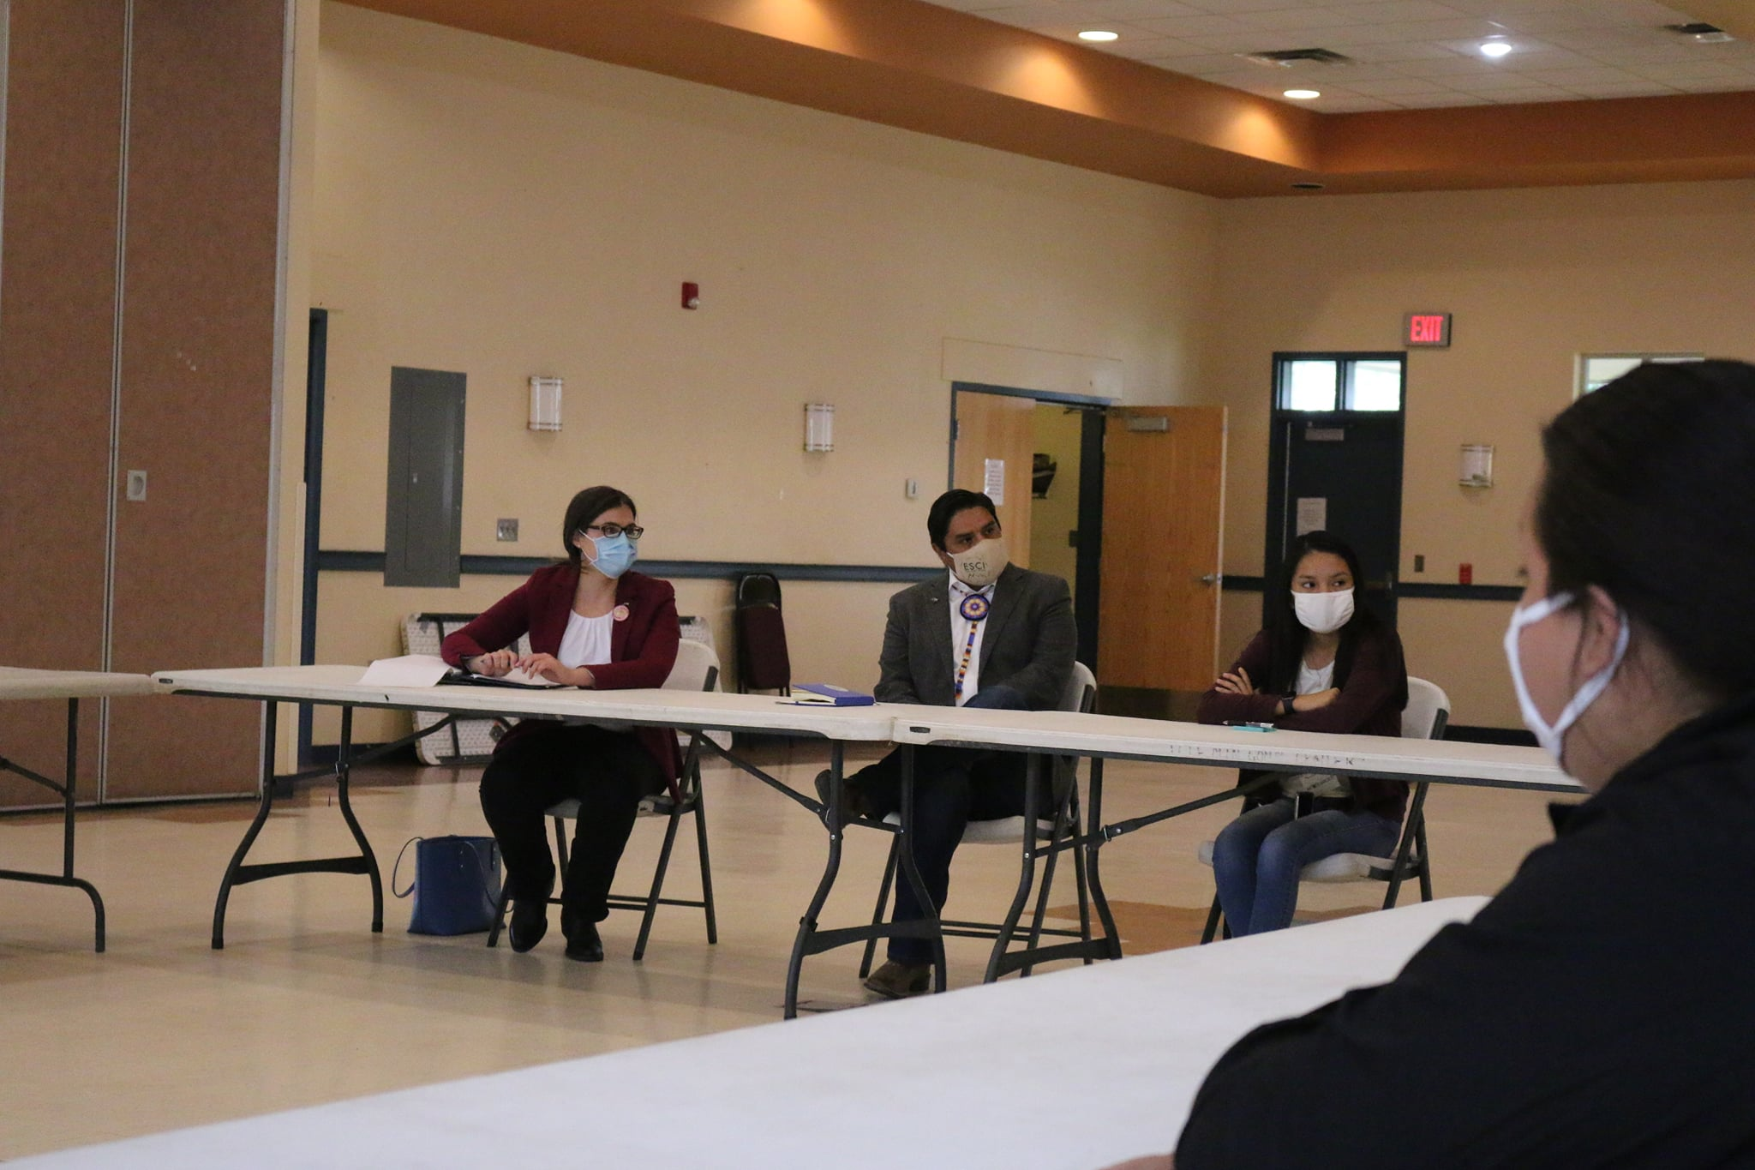

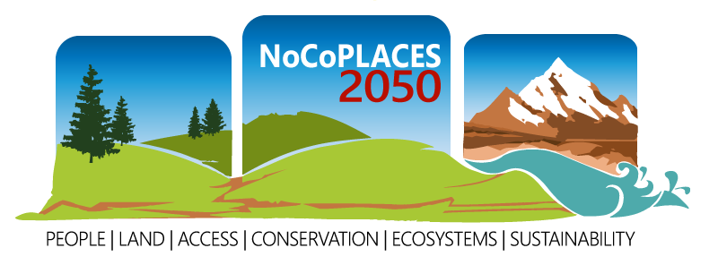
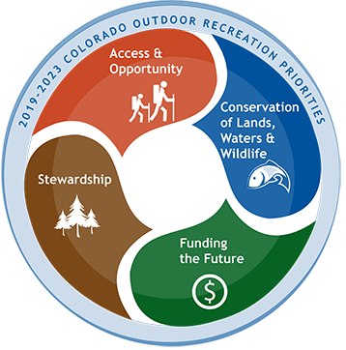
Notes:
Keystone’s mission is in helping leaders reach higher common ground. We’re a non-profit headquartered in Keystone, Colorado since 1975.
We design and facilitate public engagements, advisory groups, and coalitions throughout Colorado, the United States, and internationally.
We work in areas of natural resources, wildlife management, public lands management, recreation, agriculture, energy, environment, education and health. Some of these efforts are reflected in the images you see here; they are reflective of work that this core team has done; we’re happy to discuss these further.

Slide 4
Unique Dynamics for Wolf Reintroduction
Human Ecology
Wildlife Ecology
Outcome identified by vote
Implementation approach to be determined through collaboration
National spotlight, dynamic policy landscape
Colorado focused
Focused leadership and collaboration
Broad, equitable participation
Deliberative and adaptive
Expedient and efficient
Unique considerations for Colorado in 2021
Learnings from 2004 plan and other states
Notes:
Guiding our approach is our understanding that the controversy over wolf reintroduction in Colorado reflects the unique dynamics of our state: our diverse communities, complex interests, and contemporary rural-urban divides.
The goal is the development of a plan that can work not only for wolves, but for all Coloradans – across the state and especially at the local level of West Slope communities that will be most impacted by reintroduction. Success requires navigating the various tensions and considerations reflected here.
This includes understanding that :
this is an issue of wildlife ecology AND human ecology/human dimensions
The outcome writ large has been identified by vote, but determining how it is implemented will require collaboration
This is a Colorado-focused process that is in the national spotlight and impacted dynamic national and state policies
Accordingly we will need a process that is broad, inclusive, equitable; and with focused leadership; that is deliberative and adaptive and expedient and efficient, and that builds from the 2004 plan and lessons of other states while being attentive to the unique needs and considerations of Colorado in 2021.

Slide 5
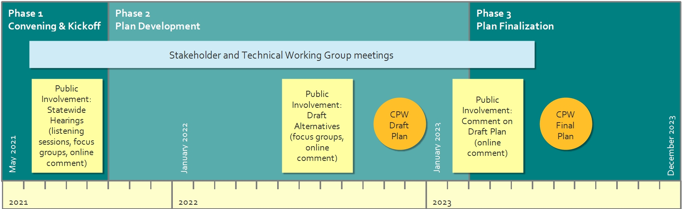
Draft Approach: Overview
Notes:
The overall approach builds from the vision that CPW staff and the Commission have adopted, with attention to the relationship between public involvement and advisory groups, and the relationship between the advisory groups themselves, and the overall timeline for plan development.
Additionally, at all points of the process, the public, stakeholders, and scientists should have clarity on how their input will inform CPW’s decisions and its development of the final plan.
Our DRAFT approach includes public involvement in all 3 phases – convening, plan development, and plan finalization – with the broadest public outreach happening in Phase 1. Our approach delivers final recommendations by early summer 2023. Should the work move more quickly, timelines can be move up.
There are many process details in our DRAFT approach– including who, what, when, where and – most importantly – why. However, all of this is DRAFT and we look forward to working with CPW to develop the details.

Slide 6
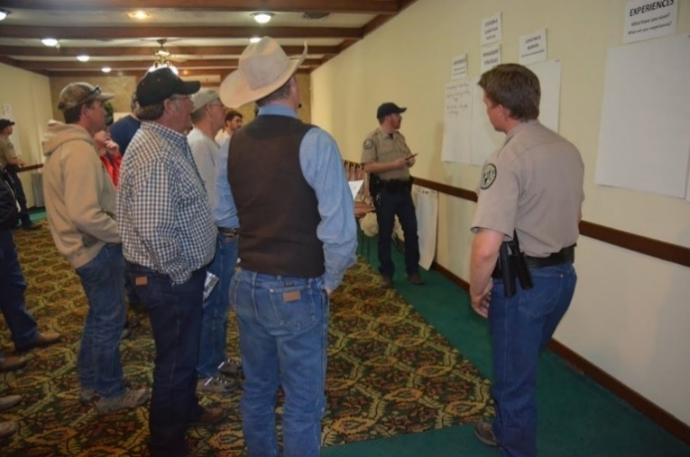
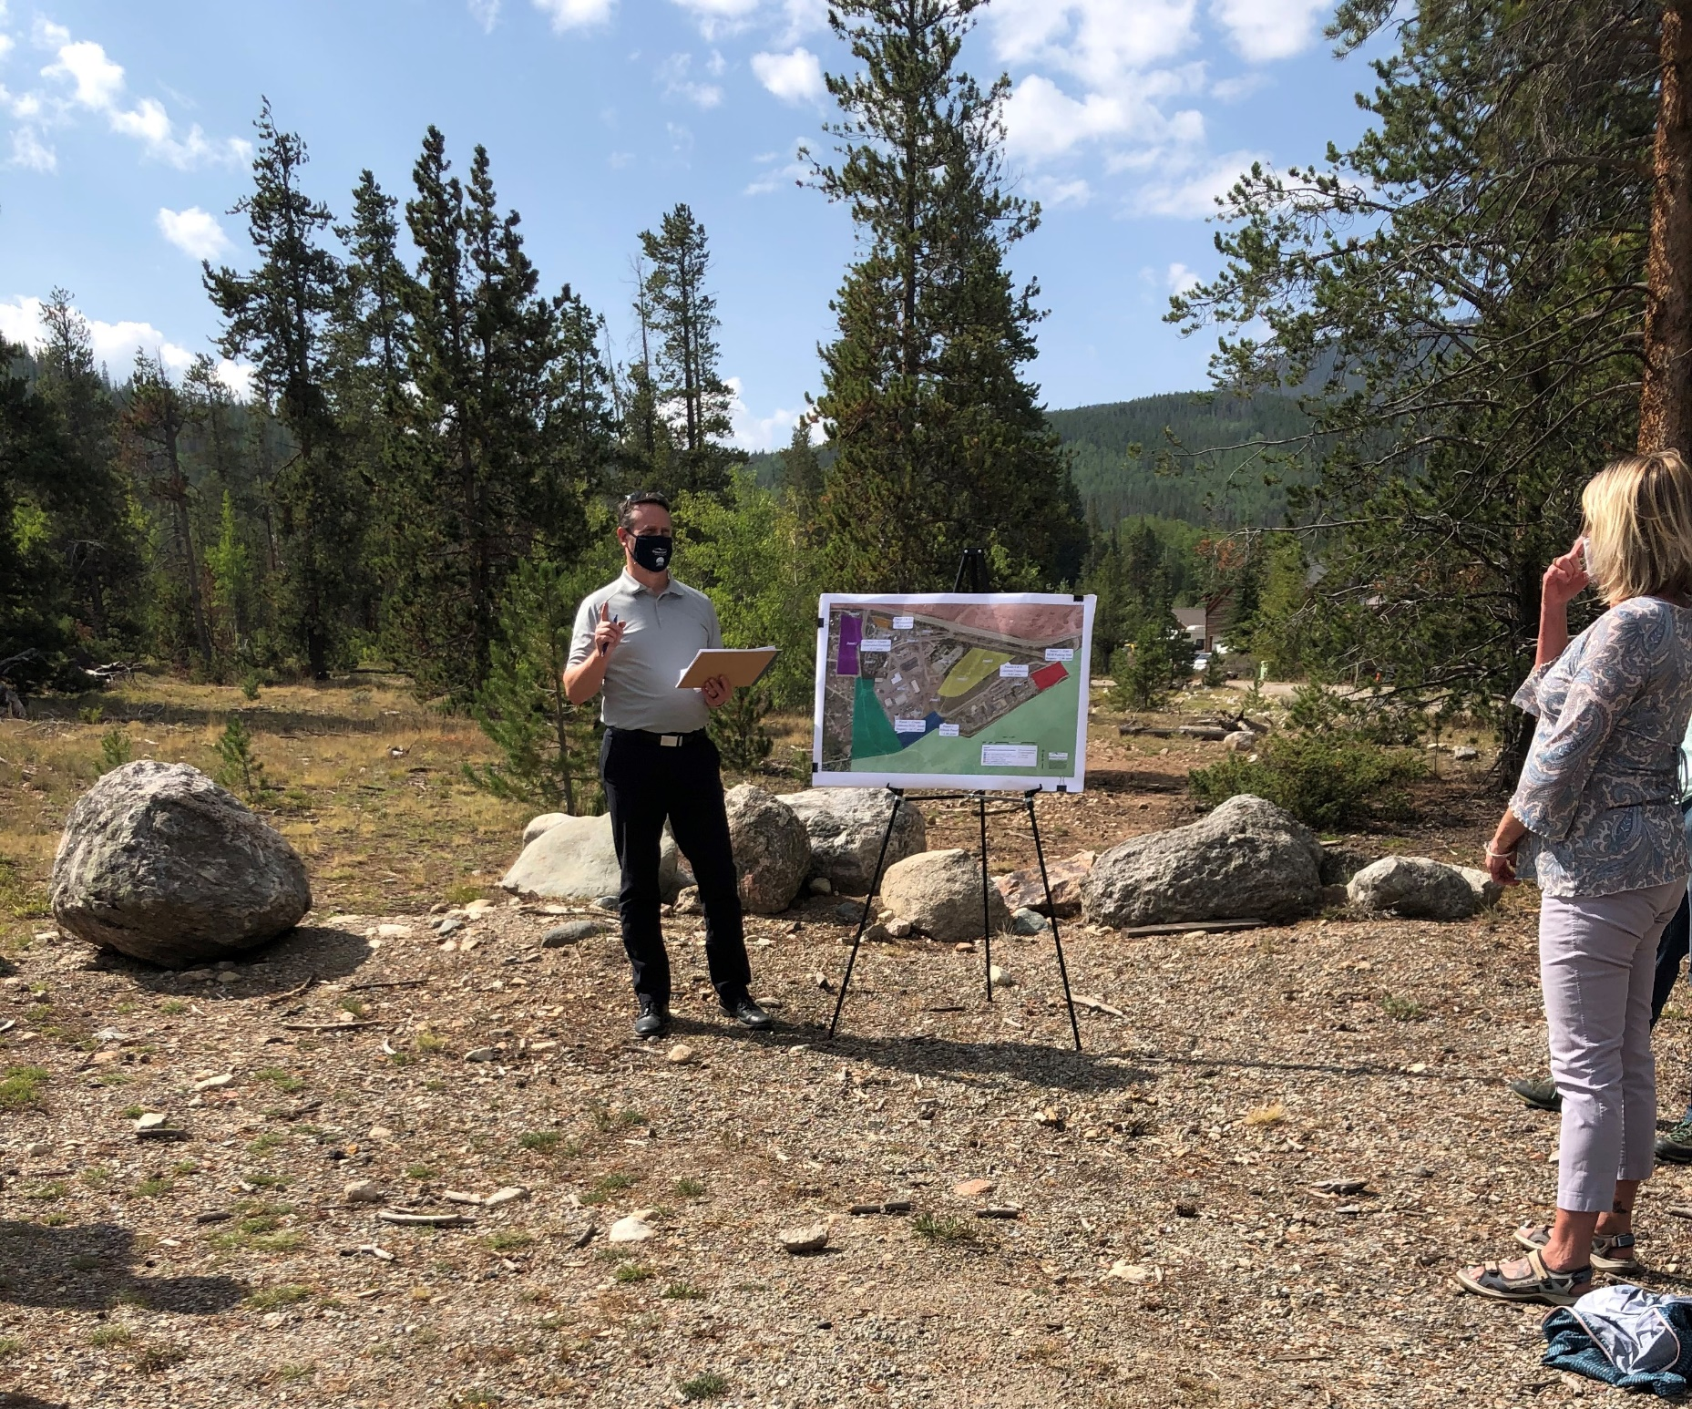
Draft Approach: Public Involvement
Offering multiple modes for engaging the public’s substantive feedback and meeting procedural needs.
Adapting during the COVID-19 pandemic.
Incorporating diversity, equity and inclusion.
Making in-person and virtual options simple and accessible, with low barriers to entry.
Notes:
Our draft approach draws from our experience learnings in public engagement throughout Colorado.
First: We suggest multiple modes for engaging. This includes:
More traditional engagement opportunities like public meetings and focus groups coupled with
asynchronous methods of engagement: online comment forms
Second: we need to design with COVID-19 precautions in mind.
We need to design to comfort levels and to adhere to whatever the current public health and DNR guidelines allow.
Larger meetings could be implemented in a in-person virtual format, and where possible, in outdoor spaces, or set-up in a way that allows for social distancing.
Because of their smaller size, focus groups can be more readily in-person, and could also be done virtually.
Third: Keystone values Equity, Diversity and Inclusion in our public engagement processes. This includes
Actively working and creating opportunities to engage with those who will be most impacted by wolf reintroduction;
And including voices that have traditionally been left out of planning processes.
Virtual and in-person options should be simple and accessible with low barriers to entry.

Slide 7
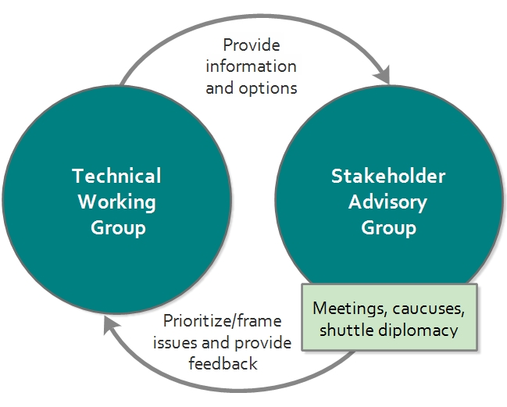
Draft Approach: Advisory Groups
Establish clear objectives, expectations and decision-making process
  Methods for defining and assessing agreement
Interactivity of Stakeholder and technical group
Utilize multiple, inclusive, responsive methods and trust-building
Notes:
For any advisory group, it’s essential to set clear expectations and objectives upfront.
We’ll need to be clear on how agreements will be defined and will be assessed; and what happens when it is not achieved.
We suggest that the advisory groups need the opportunity to interact and iterate; this should not be a linear process.
This also cannot be a cookie cutter process – we need structure and predictability on how we will approach this, but we also anticipate being adaptive, including in between meetings in order to ideate and iterate.
We would kick off the advisory group processes with individual interviews to help understand and frame the issues to be discussed and would be available throughout the process for mediation and 1:1 discussions with individual members.

