Slide 1
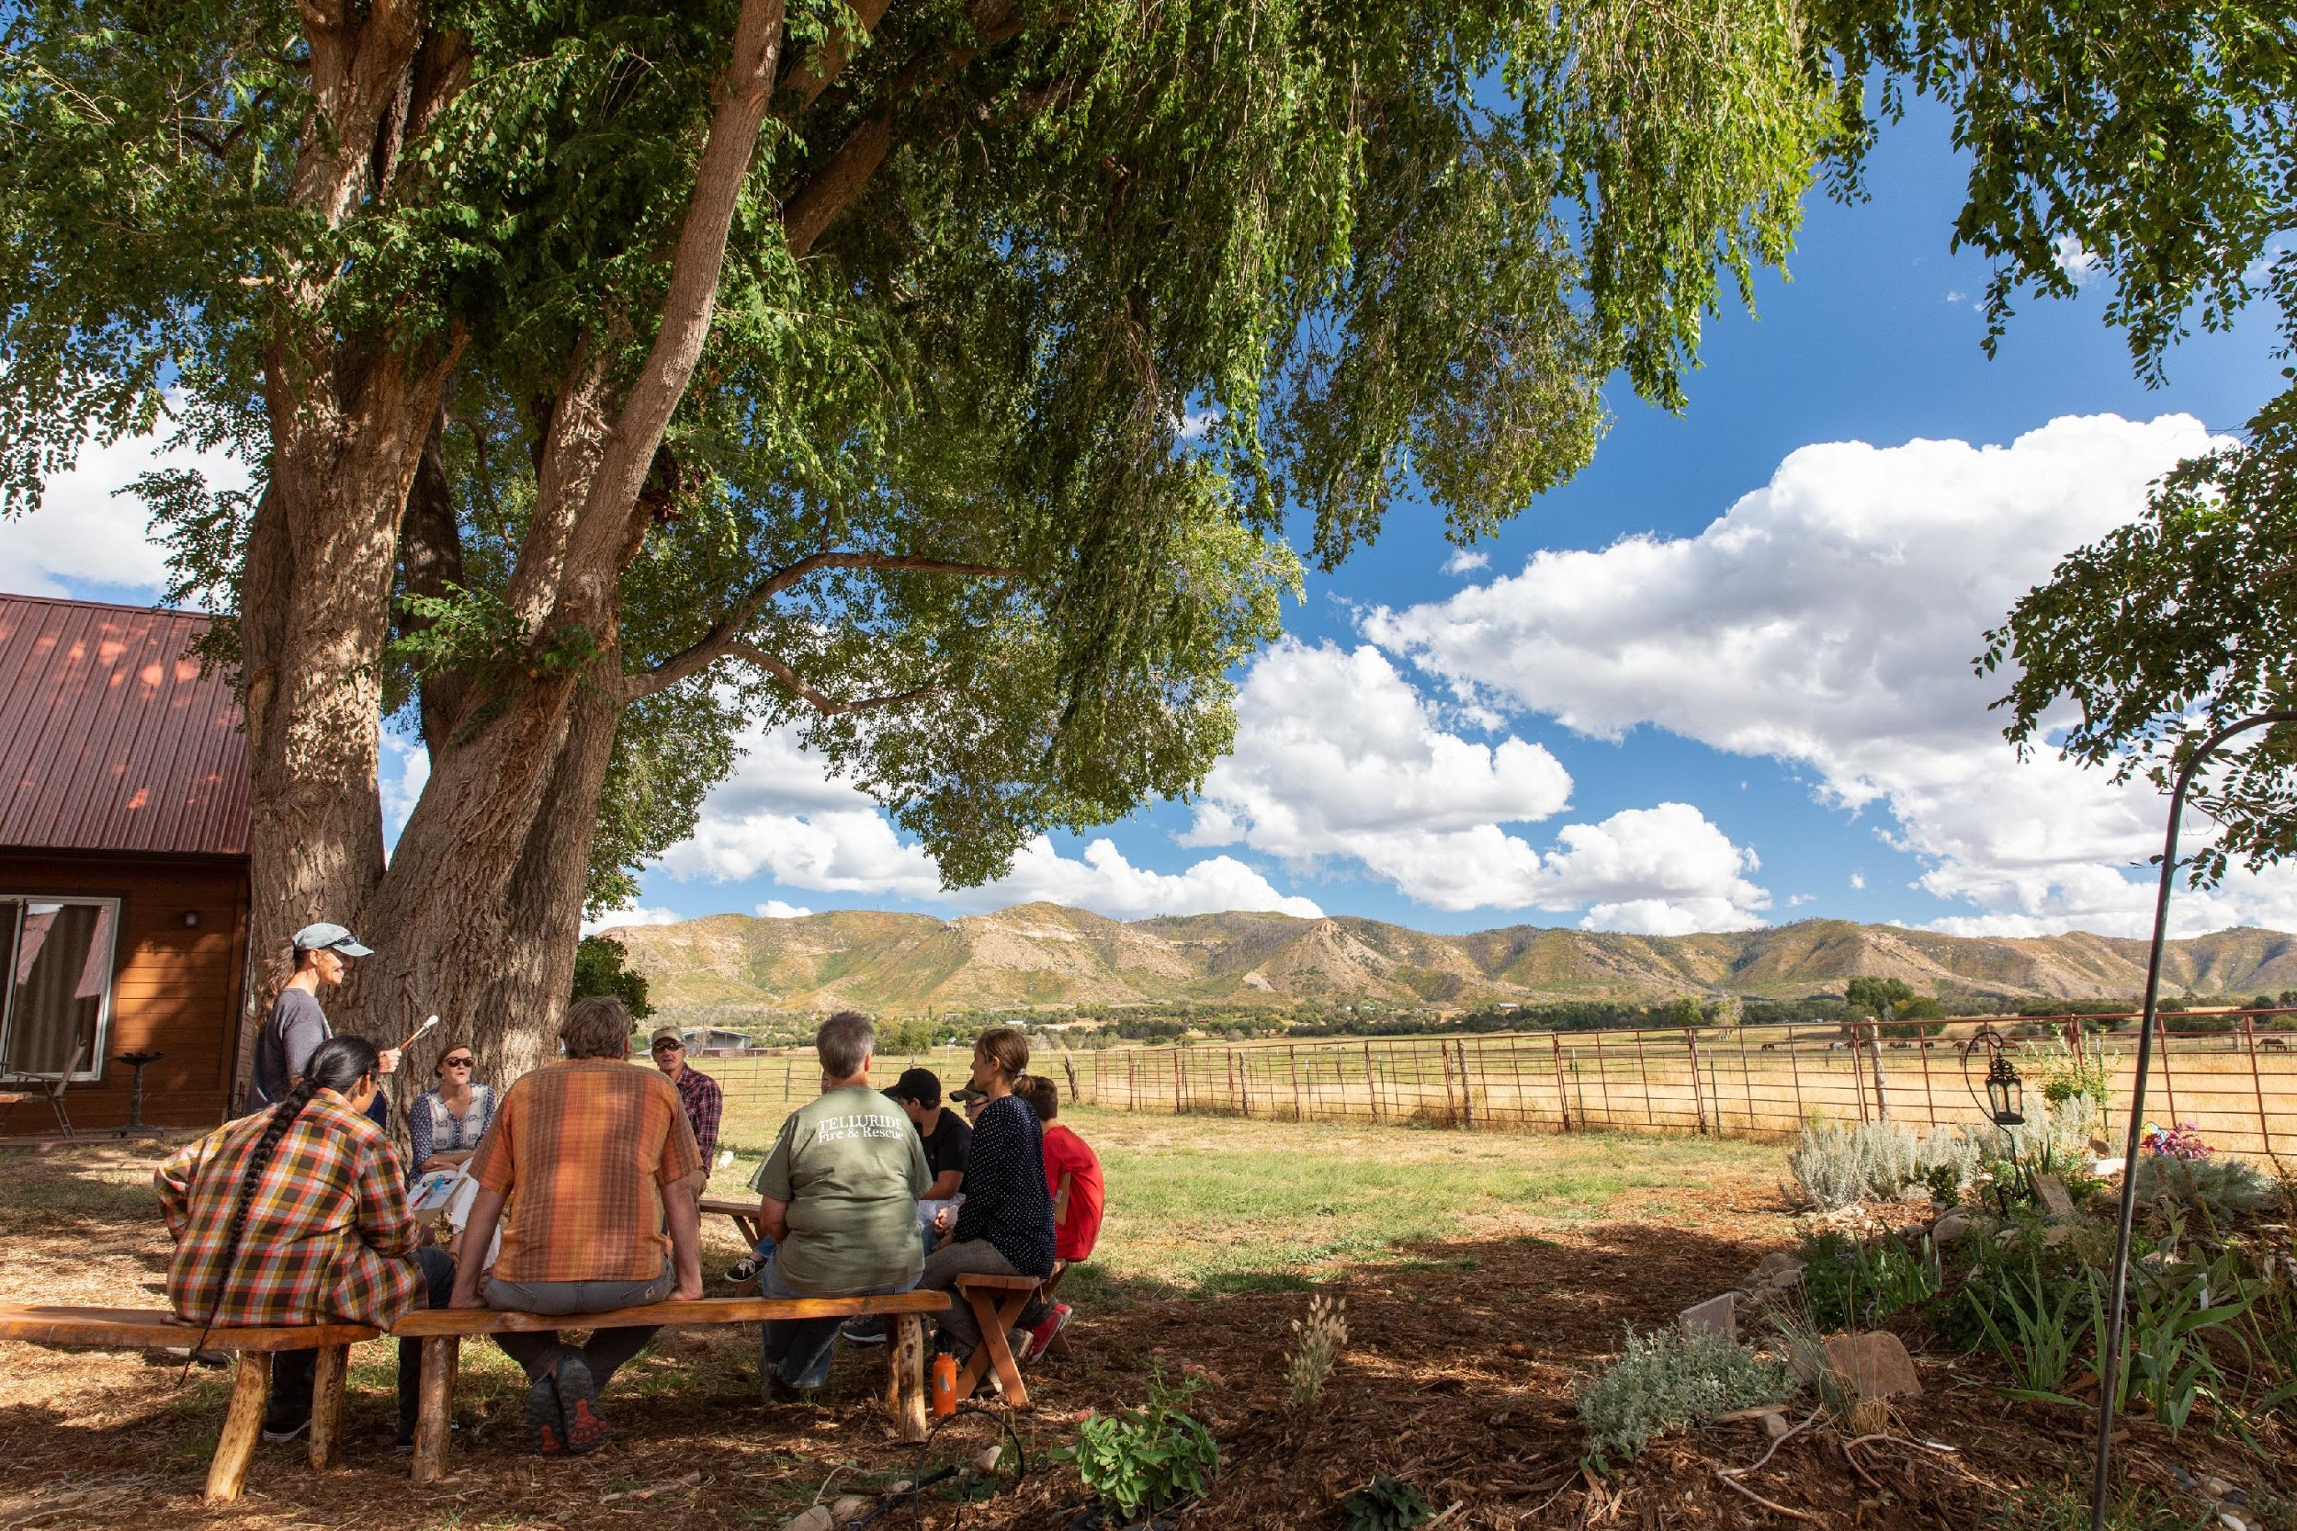
GOCO Update
La Plata County
What’s New
2020 Strategic Plan Launch
2021 CPW Director’s Innovation Fund
To help the people of Colorado preserve, protect, enhance, and manage the state’s wildlife, park, river, trails, and open space heritage.
Montezuma Inspire Coalition
Notes:
Good morning! Madam Chair, Commissioners, Directors Prenzow & Gibbs….Jake & Laura. It is my truly pleasure to be here with an update on all things GOCO in the 2 months since you last heard from us. Before I really get started, I’d like to thank Director Prenzlow and Former Chairman McDaniel for their kind words with regard to my absence as I was celebrating the life of my wonderful grandmother. On that note, I’d be remiss not to point out the irony in the first commission meeting I’ve missed in almost 8 years was also the first one I was supposed to present at.
For those of you who don’t know me, my name is Adrian Varney, and I’m GOCO’s new CPW Program Officer. A brief history on my background, prior to working with GOCO, I spent over 5 years working for CPW where I saw first hand the palpable importance CPW’s mission. I learned so much, gained so much respect for what this agency accomplishes, grew into a conservation advocate & professional, and also figured out the difference between an elk and a really large deer (true story). I also probably got more than half this agency lost at one time or another, so you can ask me about that later. In all seriousness, though, landing the job I had here was the best thing that had ever happened to me – from the knowledge to the people to the positive impact.
3 years ago I couldn’t say no to an opportunity to work with Great Outdoors Colorado. Some still claim I was “poached” by GOCO, to which I’m pressed to reiterate again “that GOCO fully supports CPW’s Fair Chase Principles.” Now, really, I get to exist in the best of both worlds, working with 2 organizations that really share my passions and values.
That being said, I have a pretty robust update for you and not a lot of time, so I’ll move on to what’s happening in the county.

Slide 2
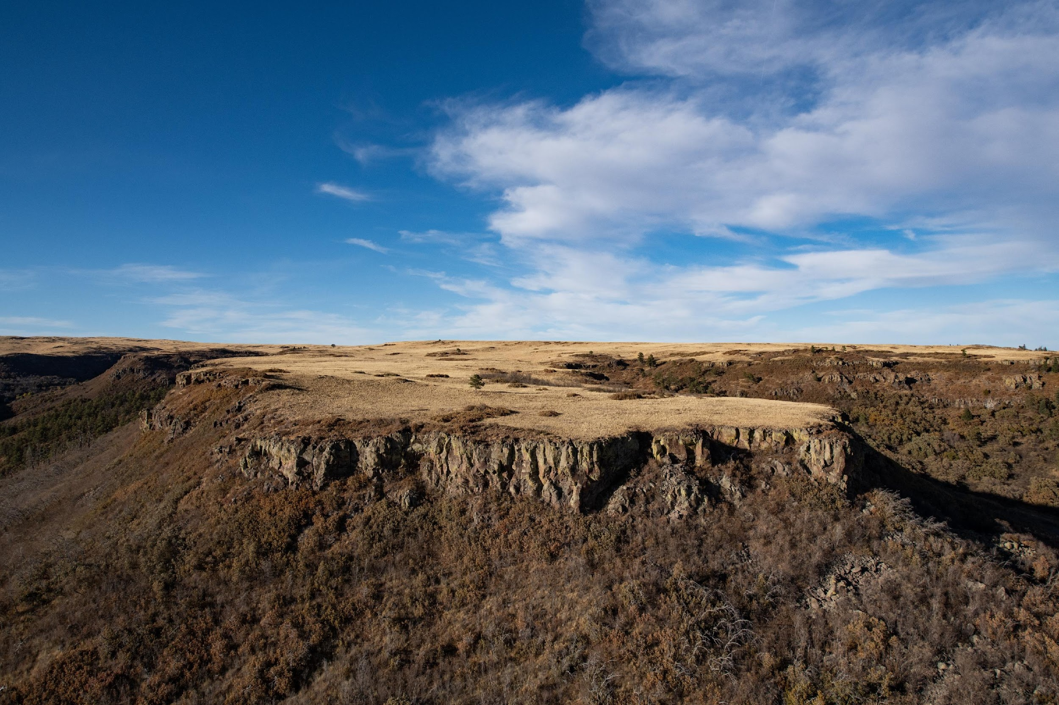
La Plata County Investments: $12,259,537
CPW Investments: $1,335,973
Vallecito Reservoir
Haviland Lake Dam Rehabilitation
Durango Nature Trail
City of Durango Investments: $9,149,880
Jacob’s Cliff’s
Durango Animas River Greenway Trail Connection
Fishers Peak State Park, Las Animas County
Dolores Elementary School Garden, Dolores
Notes:
Here in La Plata County, GOCO has invested over $12 Million over the years.
CPW investments total almost $1.3 million, with the SW Region here developing a strong theme centered around increased and improved ADA Access and Inclusion highlighted in their extensive county-wide trail work, facility additions and improvements, and capital maintenance..
The City of Durango itself has seen over $9 Million including:
$3 Mil toward the 2005 fee title purchase the Jacob’s Cliff’s parcels, adding 176 previously unprotected acres to their larger vision for Animas Mountain at the time (Animas Mountain: a parcel of land that provides critical winter-range for deer and elk as well as passive recreational opportunities such as hiking and rock climbing as a fully protected resource for the local community and wildlife. )
AND
Durango Area Trails Alliance Stewardship Collaboration – A youth corps Project addressing the record breaking season of trail use during COVID-19. Multiple partners came together to hire Southwest Conservation Corps to conduct extensive trail stewardship after the unprecedented use during the pandemic.

Slide 3
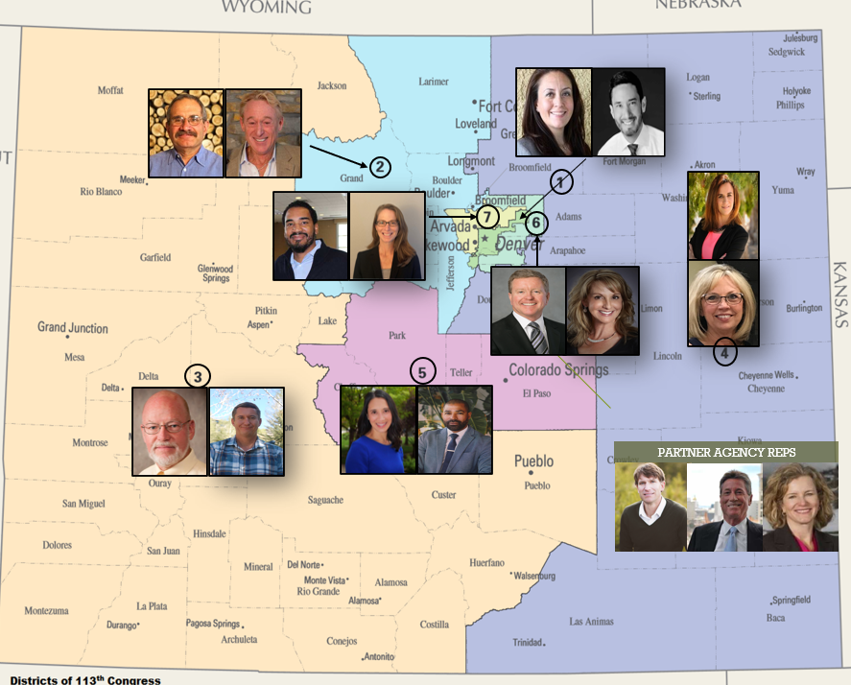
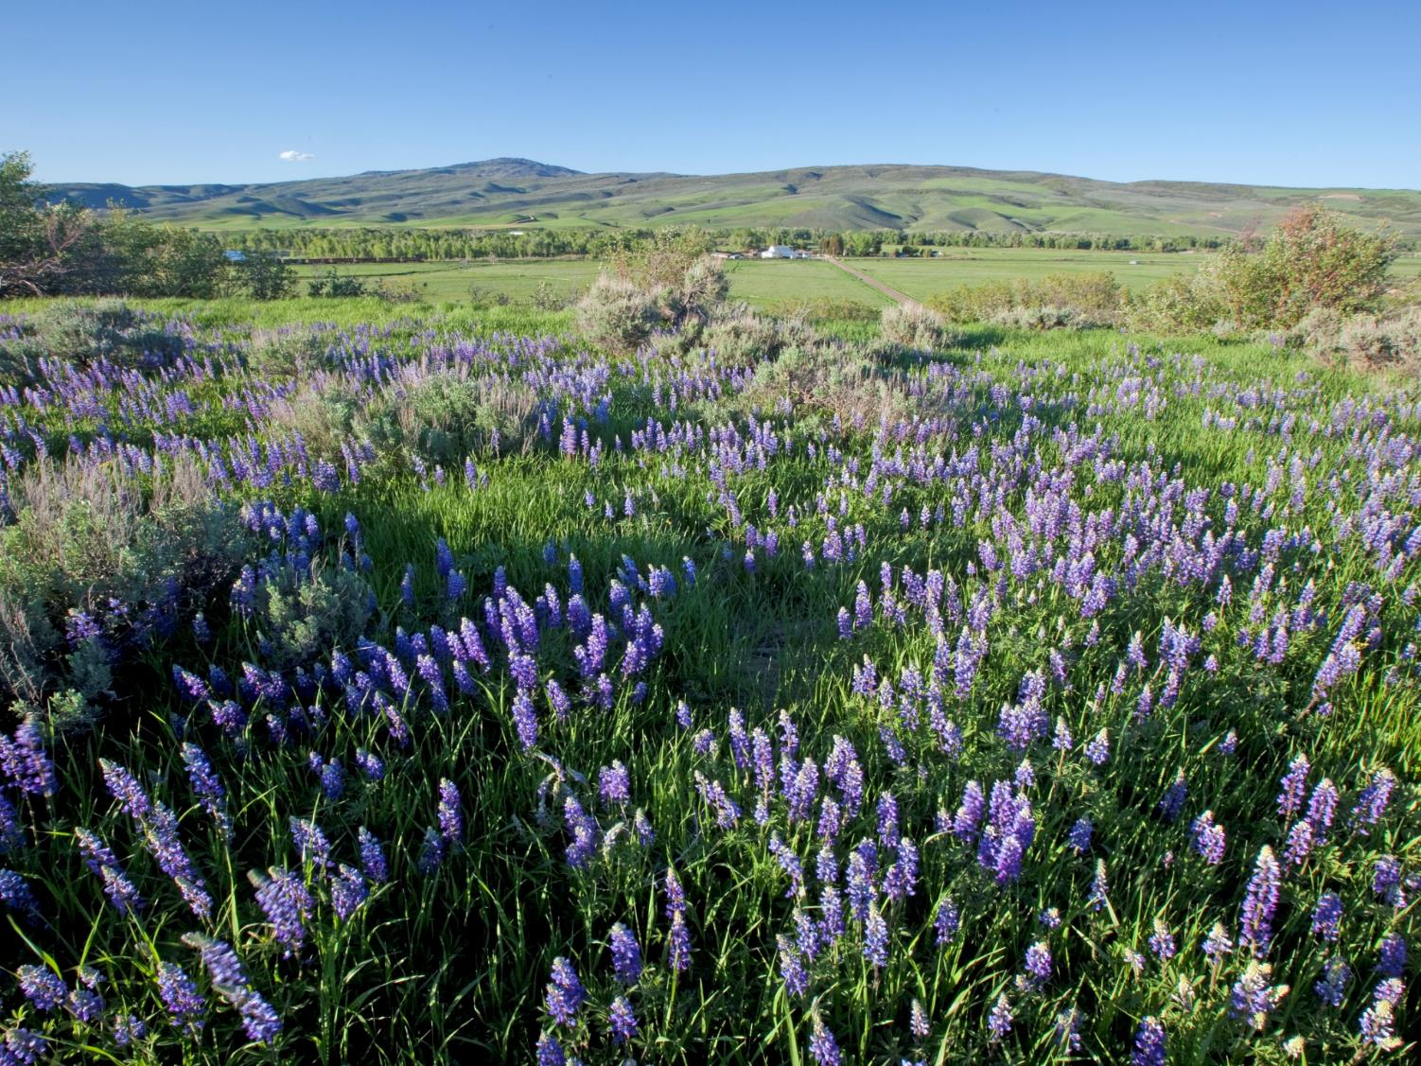
Notes:
You’ve probably all heard we welcomed seven new board members in June. Also appointed by the Governor and confirmed by the State Senate, our board members have their hands full with setting strategy and approving our spending plans, grant programs, and all grant awards – especially this year now that we’re operating within parameters of our new Strategic Plan..
GOCO’s Board Members are as follows:
District 1= Leticia Martinez (U) from Denver and Rick Palacio (D) from Denver
District 2= Turk Montepare (U) from Breckenridge and Mo Siegel (D) from Boulder
District 3= David Cockrell (U) from Pueblo and Craig Hughes (D) from Eagle
District 4= Pamela Denahy (R) from La Junta and Brenda May (U) from Lamar
District 5= Tony Rosenda (D) from Colorado Springs and Mina Liebert (U) from Colo Springs
District 6= Patty Imhoff (D) from Greenwood Village and Tom Lee (R) from Greenwood Village
District 7= Jahi Simbai (U) from Wheat Ridge and Carrie Curtiss (D) from Golden
Partner Agency Reps= Dan Gibs DNR, Charles Garcia CPW Commission, and Carrie Besnette Hauser CPW Commission

Slide 4
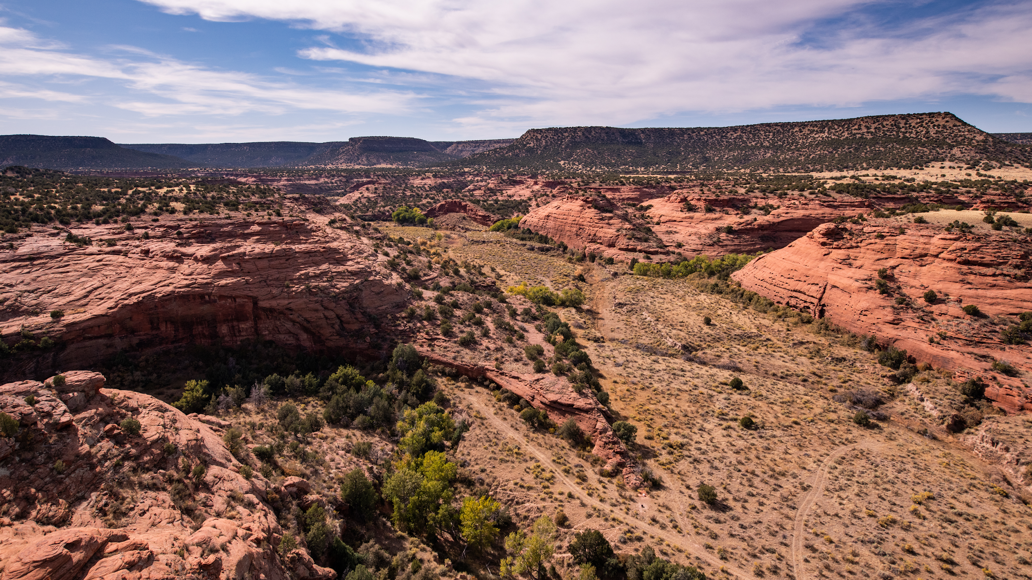
2020 Strategic Plan: An Informed Future
Evolved approach to grantmaking and engagement
Optimized program portfolio & established program values
Regional Staffing Model
Responsive to GOCO’s Equity Principles:
Accessibility | Community-centered Approach | Education and Support | Communications
Cameron Davidson, courtesy of The Nature Conservancy
Notes:
Which you’ve all heard a lot about. The last 2 years worth of updates here were centered on the creation of our 2020 Strategic plan. As you all know, it was a period of learning, prioritization, and growth as we listened to diverse groups of partners to understand their barriers, challenges and innovative ideas, and also went down the rabbit hole challenging ourselves to dive deep into our own.
Since our boards approval of our plan in June of 2020, we’ve worked non-stop on implementation strategy. And finally, on July 1st, GOCO staff and our Board officially launched this transformational strategic plan that elevates many of the tenets we’ve been grounded in during our 28-year history and helps us evolve. It outlines our organizational values and bases our programs in them; applies an equity lens across our programs, operations, and decision-making processes; and re-imagines how we might best serve Colorado communities from within communities.

Slide 5
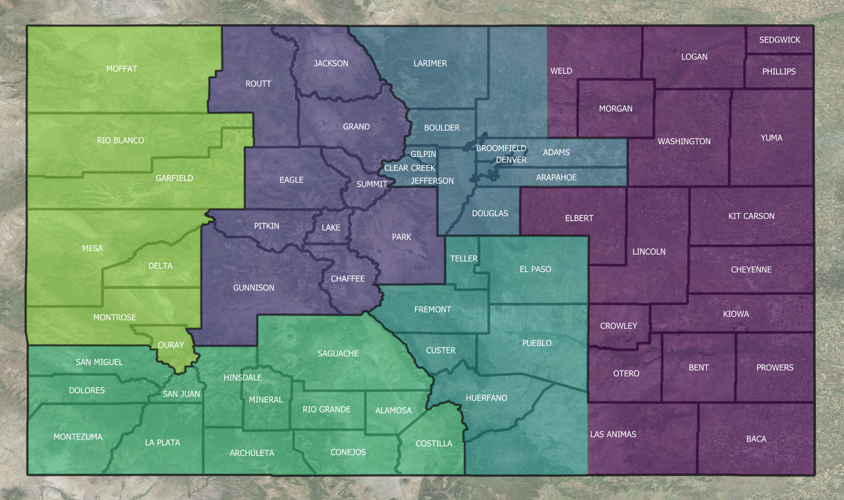
Regional Approach
Northern
Front
Range
North
Central
West
East
Southern
Front
Range
Southwest
Notes:
Which brings us to where we are today. For the first time in GOCO’s nearly 30 year history we are no longer solely based in Denver. We listened during our strategic planning process and we heard what our stakeholders said. State-wide, we were asked for locally based staff, and six regional officers are now part of our program structure. Our goal is to have a deeper understanding of the needs and opportunities of the communities that we serve and having the regional officers there, embedded in those communities as those literal boots on the ground to facilitate that understanding and learning is the first step.
So, what we did was try to create some similarity among the communities in these regions, and while it’s been and still is a work in progress – we’ll feel like we haven’t completely missed the mark here at getting close to a true regional representation.
I’ll take this moment to introduce our Southwest Regional Officer, Estrella Woods. Estrella shares a passion of the outdoors, parks, and open space with GOCO and has a background in Environmental Studies, and we’re very excited for what she brings to the team.
So, in additional to our regional approach, we’ve had across the board changes to our staffing, including some previous contacts moving into new roles, including myself, and many new staffers have joined us, so we’ve grown a bit.
ANd if that wasn’t quite enough change for you– Beginning this month, Jackie Miller, our past Director of Programs, has stepped into an interim executive director role as last month we bid farewell to outdoor champion Chris Castilian, who served as GOCO’s Executive Director for four years. I had the pleasure of meeting and working with Chris years ago when I was working at CPW and he was serving on this Commission, and it’s been an honor and a privilege working with him since day one.
Northern Front Range- Alex Castino Southern Front Range - Tilah Larson
West - Katie Smith North Central - Dan Omasta
Southwest - Estrella Woods East - Sammie George

Slide 6
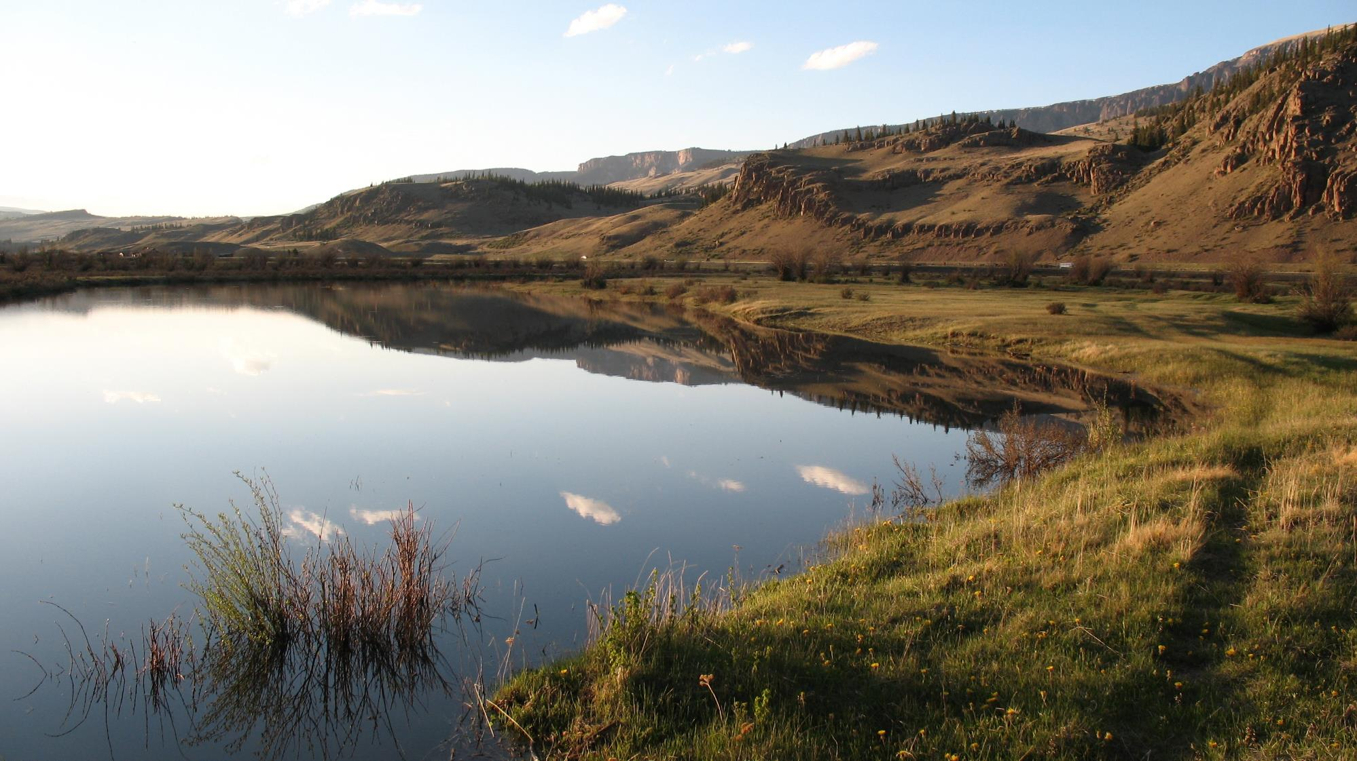
Program Portfolio
Land Conservation Program
Centennial Program
Community Impact Program
Generation Wild
Planning & Capacity Program
Fellowship Program
Stewardship Impact Program
Colorado Parks & Wildlife
RESTORE
Director’s Innovation Fund
Conservation Service Corps
San Luis Valley
Notes:
So, it’s full steam ahead now – with a fully staffed roster and also a fully developed program portfolio that is streamlined and aligned with our programmatic values of resource conservation, outdoor stewardship, community vitality, equitable access, and youth connections.
We’re proud to have developed a program portfolio that truly prioritizes the Colorado way of life.
As you can see, GOCO will continue to run competitive grant programs for park and trail development, land conservation, and stewardship projects across Colorado. The types of projects and outcomes that have driven GOCO’s grantmaking since 1992 will persist, but our organization’s approach has evolved and will continue to evolve.
Land Conservation | Land conservation projects that protect significant conservation values and connect people to place..
Community Impact | Capital projects that enhance a community’s access to the outdoors and its quality of life. This replaces our “LPOR” programs, wrapping them all into 1. Includes the design, planning, and all the way through the activation of a project, eliminating the need for folks to come back in phases. This grants awards all in one lump promising funding for an entire project, as long as benchmarks are reached throughout the project.
Planning and Capacity | Investing in research, education, planning, and capacity-building projects that address trends, issues, and opportunities in the outdoors.
Stewardship | Investing in restoring, enhancing, and sustaining Colorado’s natural and outdoor recreational resources by increasing the scale of habitat restoration efforts, amplifying the work of outdoor stewardship organizations, and enhancing the impact of conservation service corps. Stewardship Impact grants will enhance the volunteer based efforts to accomplish more comprehensive stewardship opportunities. RESTORE also lives in this program. This is our attempt to “up the game” with regard to large scale stewardship opportunities and habitat restoration. GOCO is partnered with NFWF, Gates Family Foundation, DNR, CPW, and the Colorado Conservation Board to fund this annual grant cycle managed by NFWF
Centennial Program | These are high-value, once-in-a-lifetime projects with lasting impacts for the state and future generations of its people, like Fisher’s Peak, where GOCO leveraged $7 million in CPW funding to complete.
Generation Wild | Our “premier” program from our 2015 strategic plan focused on advancing equitable access to the outdoors through local coalitions that provide program and pathway opportunities to youth and families who might not otherwise have them.
Fellowship | New in 2021, the GOCO Fellowship Program offers young people from diverse backgrounds an opportunity to prepare for careers in the outdoors, gaining meaningful experience in the fields of conservation, outdoor recreation, and stewardship and growing a professional skillset to apply to future endeavors.

Slide 7
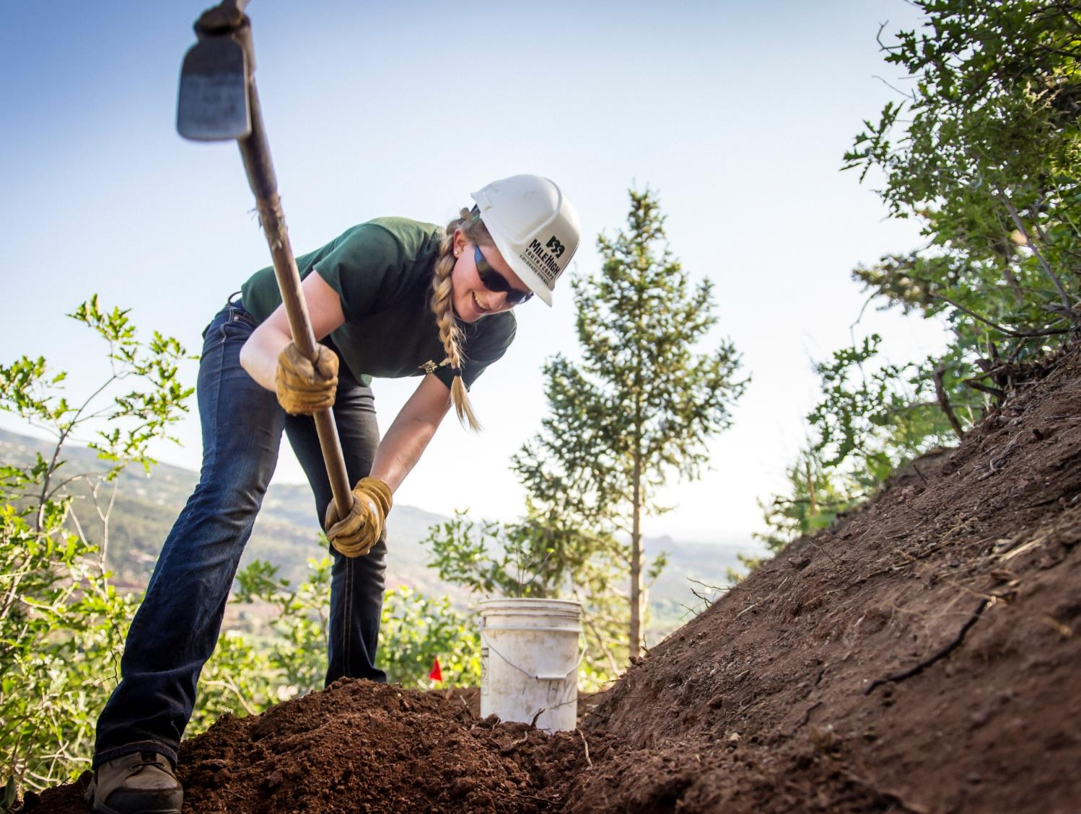
CPW Director’s Innovation Fund
Program designed to support and benefit CPW field staff with small grants
Funded projects with high visibility and significant visitor benefit
Unforeseen secondary benefits
GOCO staff and board education, increased understanding of CPW
Project specific impacts
Creates a stronger CPW/GOCO relationship throughout the agency
Iron Horse Trail, Colorado Springs
Notes:
To speak to one of those specific programs, in June, the GOCO board awarded the 2021 slate of the CPW Director’s Innovation Fund (DIF as we call it). DIF is a competitive grant program open to all CPW staff for creative, one-time projects that typically don’t require on-going funding and are not funded annually through GOCO or other sources for both the parks and wildlife purpose projects. The program was developed in 2017 in collaboration with CPW to give field staff the opportunity to fund small but impactful projects, an opportunity they really didn’t have prior to this program. The response was overwhelming the first year, with over 30 applications totaling over half a million in requests - so the demand was there.
Now in its 5th year, this program has provided years worth meaningful insight to GOCO staff and board that has helped shape some of our decision making processes that have resulted in tremendous benefits. My goal is to continue to grow this program’s awareness within CPW so that we continue to see even more truly innovative and exciting projects come through.
This year's slate of funded projects will only add to the significant benefits CPW stakeholders get to enjoy via the highly visible and impactful projects DIF has already helped to get on the ground. **NEXT SLIDE**

Slide 8
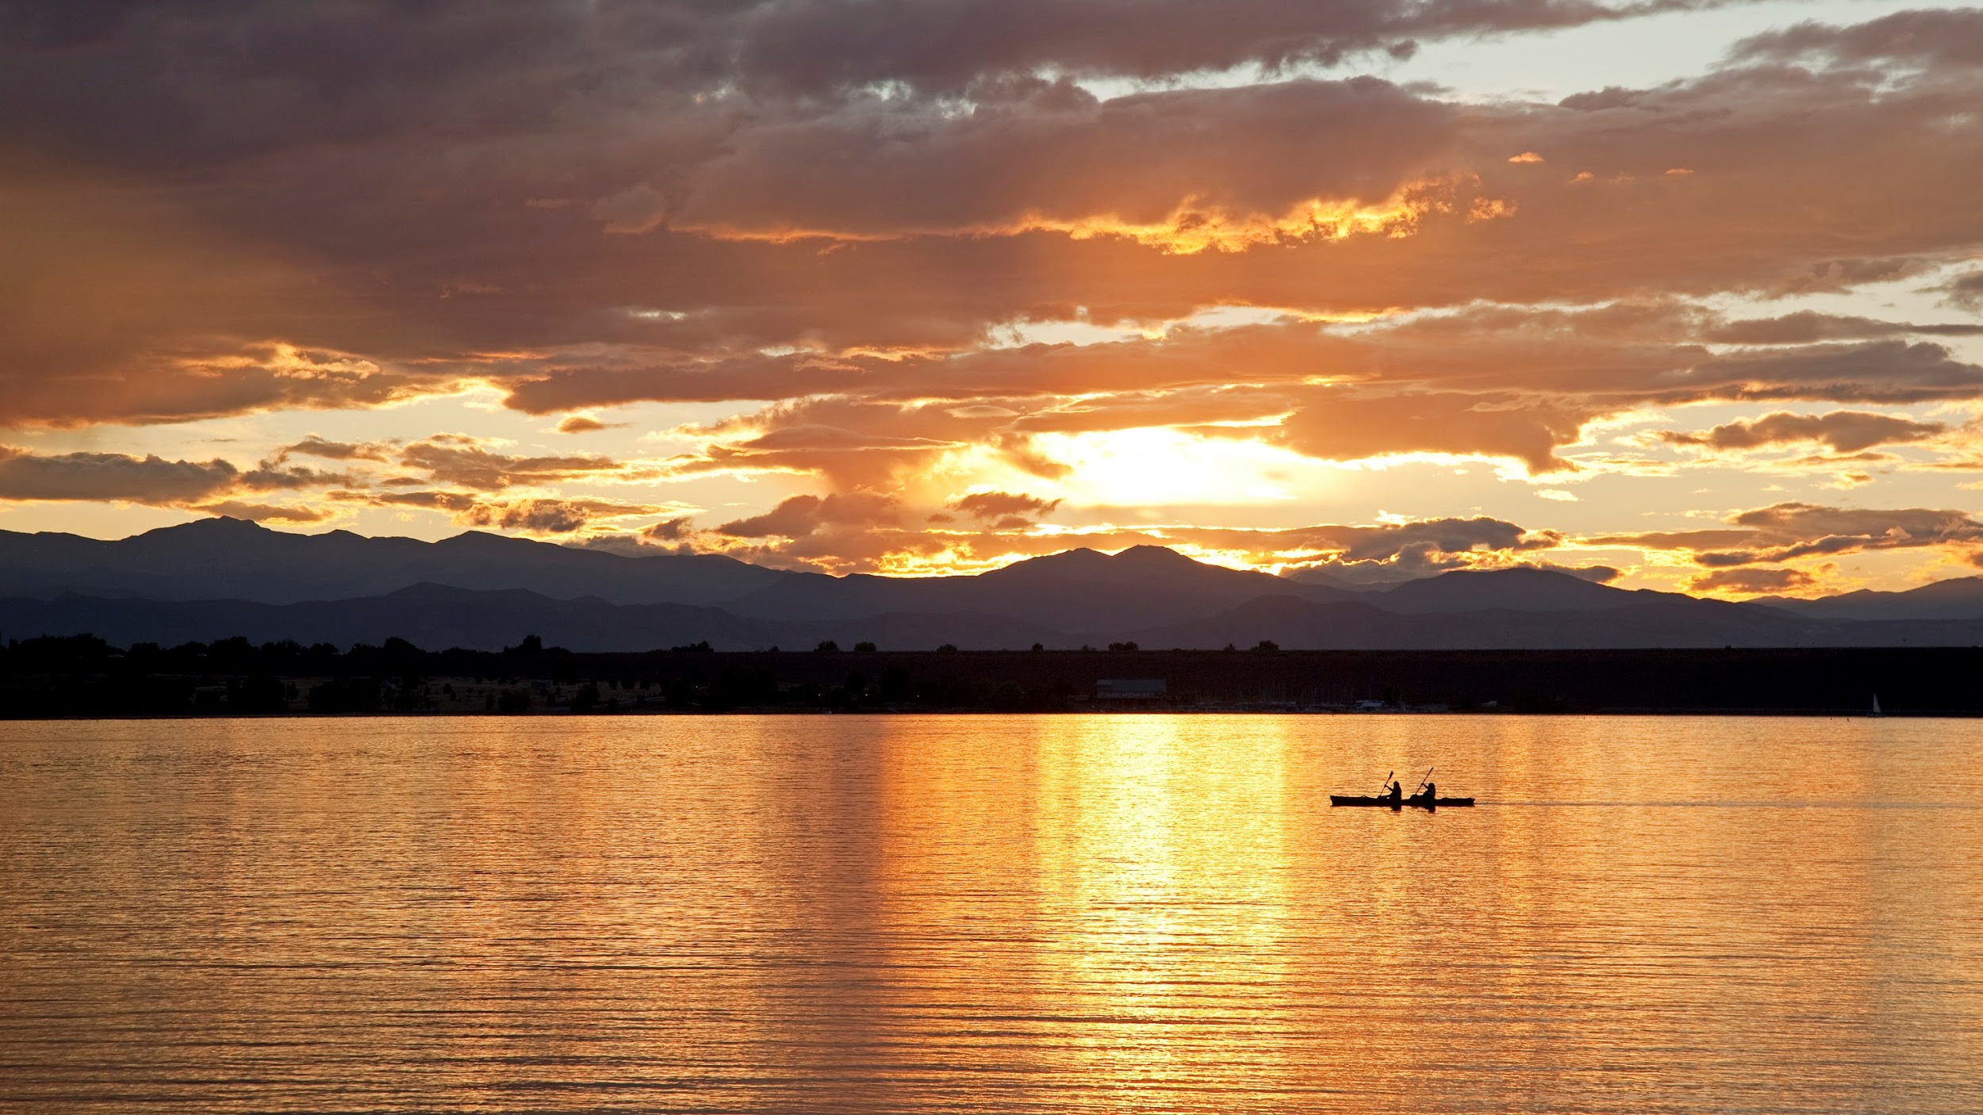
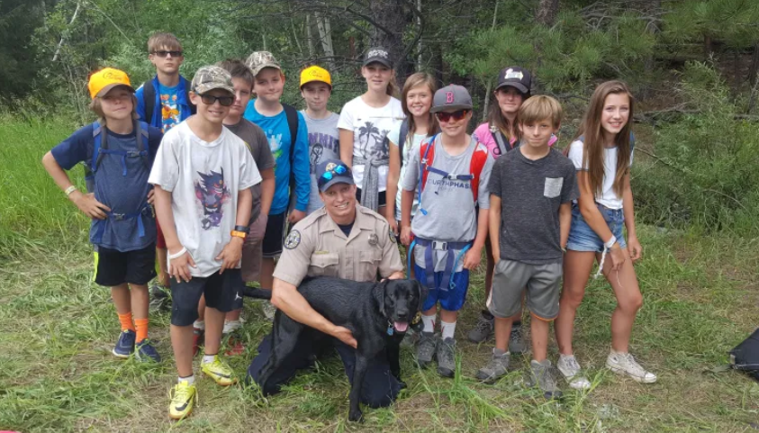
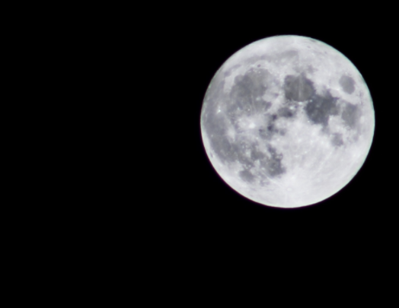
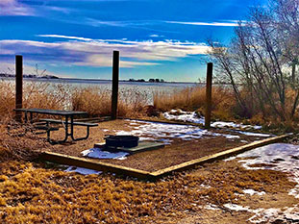
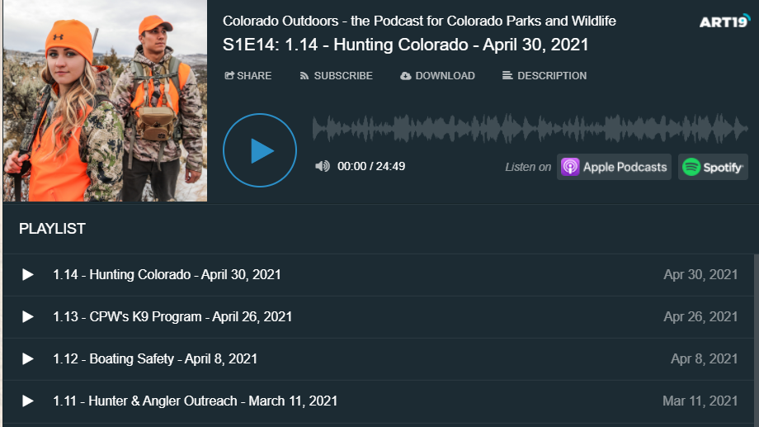
CPW Director’s Innovation Fund
Notes:
Speaking of some of those projects already on the ground, Here’s a quick glance at some previously awarded DIF Projects.
You’ll likely remember Grand Junction’s meeting in May, you all saw a powerful presentation on the Outdoor Wilderness Lab. 2017 DIF funds were awarded and used to expand the program in 2018 to include all sixth graders, rather than the small group of kids they were able to pilot OWL with. Now in their 9th year, they serve all 8 middle schools in the district and had 1,350 6th graders go through the program in the 2019-2020 school year, despite the onset of the pandemic. With exciting ambitions to go statewide in the future.
Another DIF project that continues to inspire current applications is 2020’s Jackson Lake State Park’s successful certification with the Dark Skies Initiative. Now one of our governor’s priorities, Jackson Lake joined places like Dinosaur & Hovenweep National Monuments & Great Sand Dunes, Black Canyon of the Gunnison, and Mesa Verde National Parks with their Dark Skies Certifications CPW’s second state park to seek certification, Rifle Gap, was funded in this year’s round
The other projects you see here are very popular projects from the past Cash, the Wildlife Canine, CPW’s Podcast and Rifle Gap Hammock camping … whew… say that 3 times fast!

Slide 9
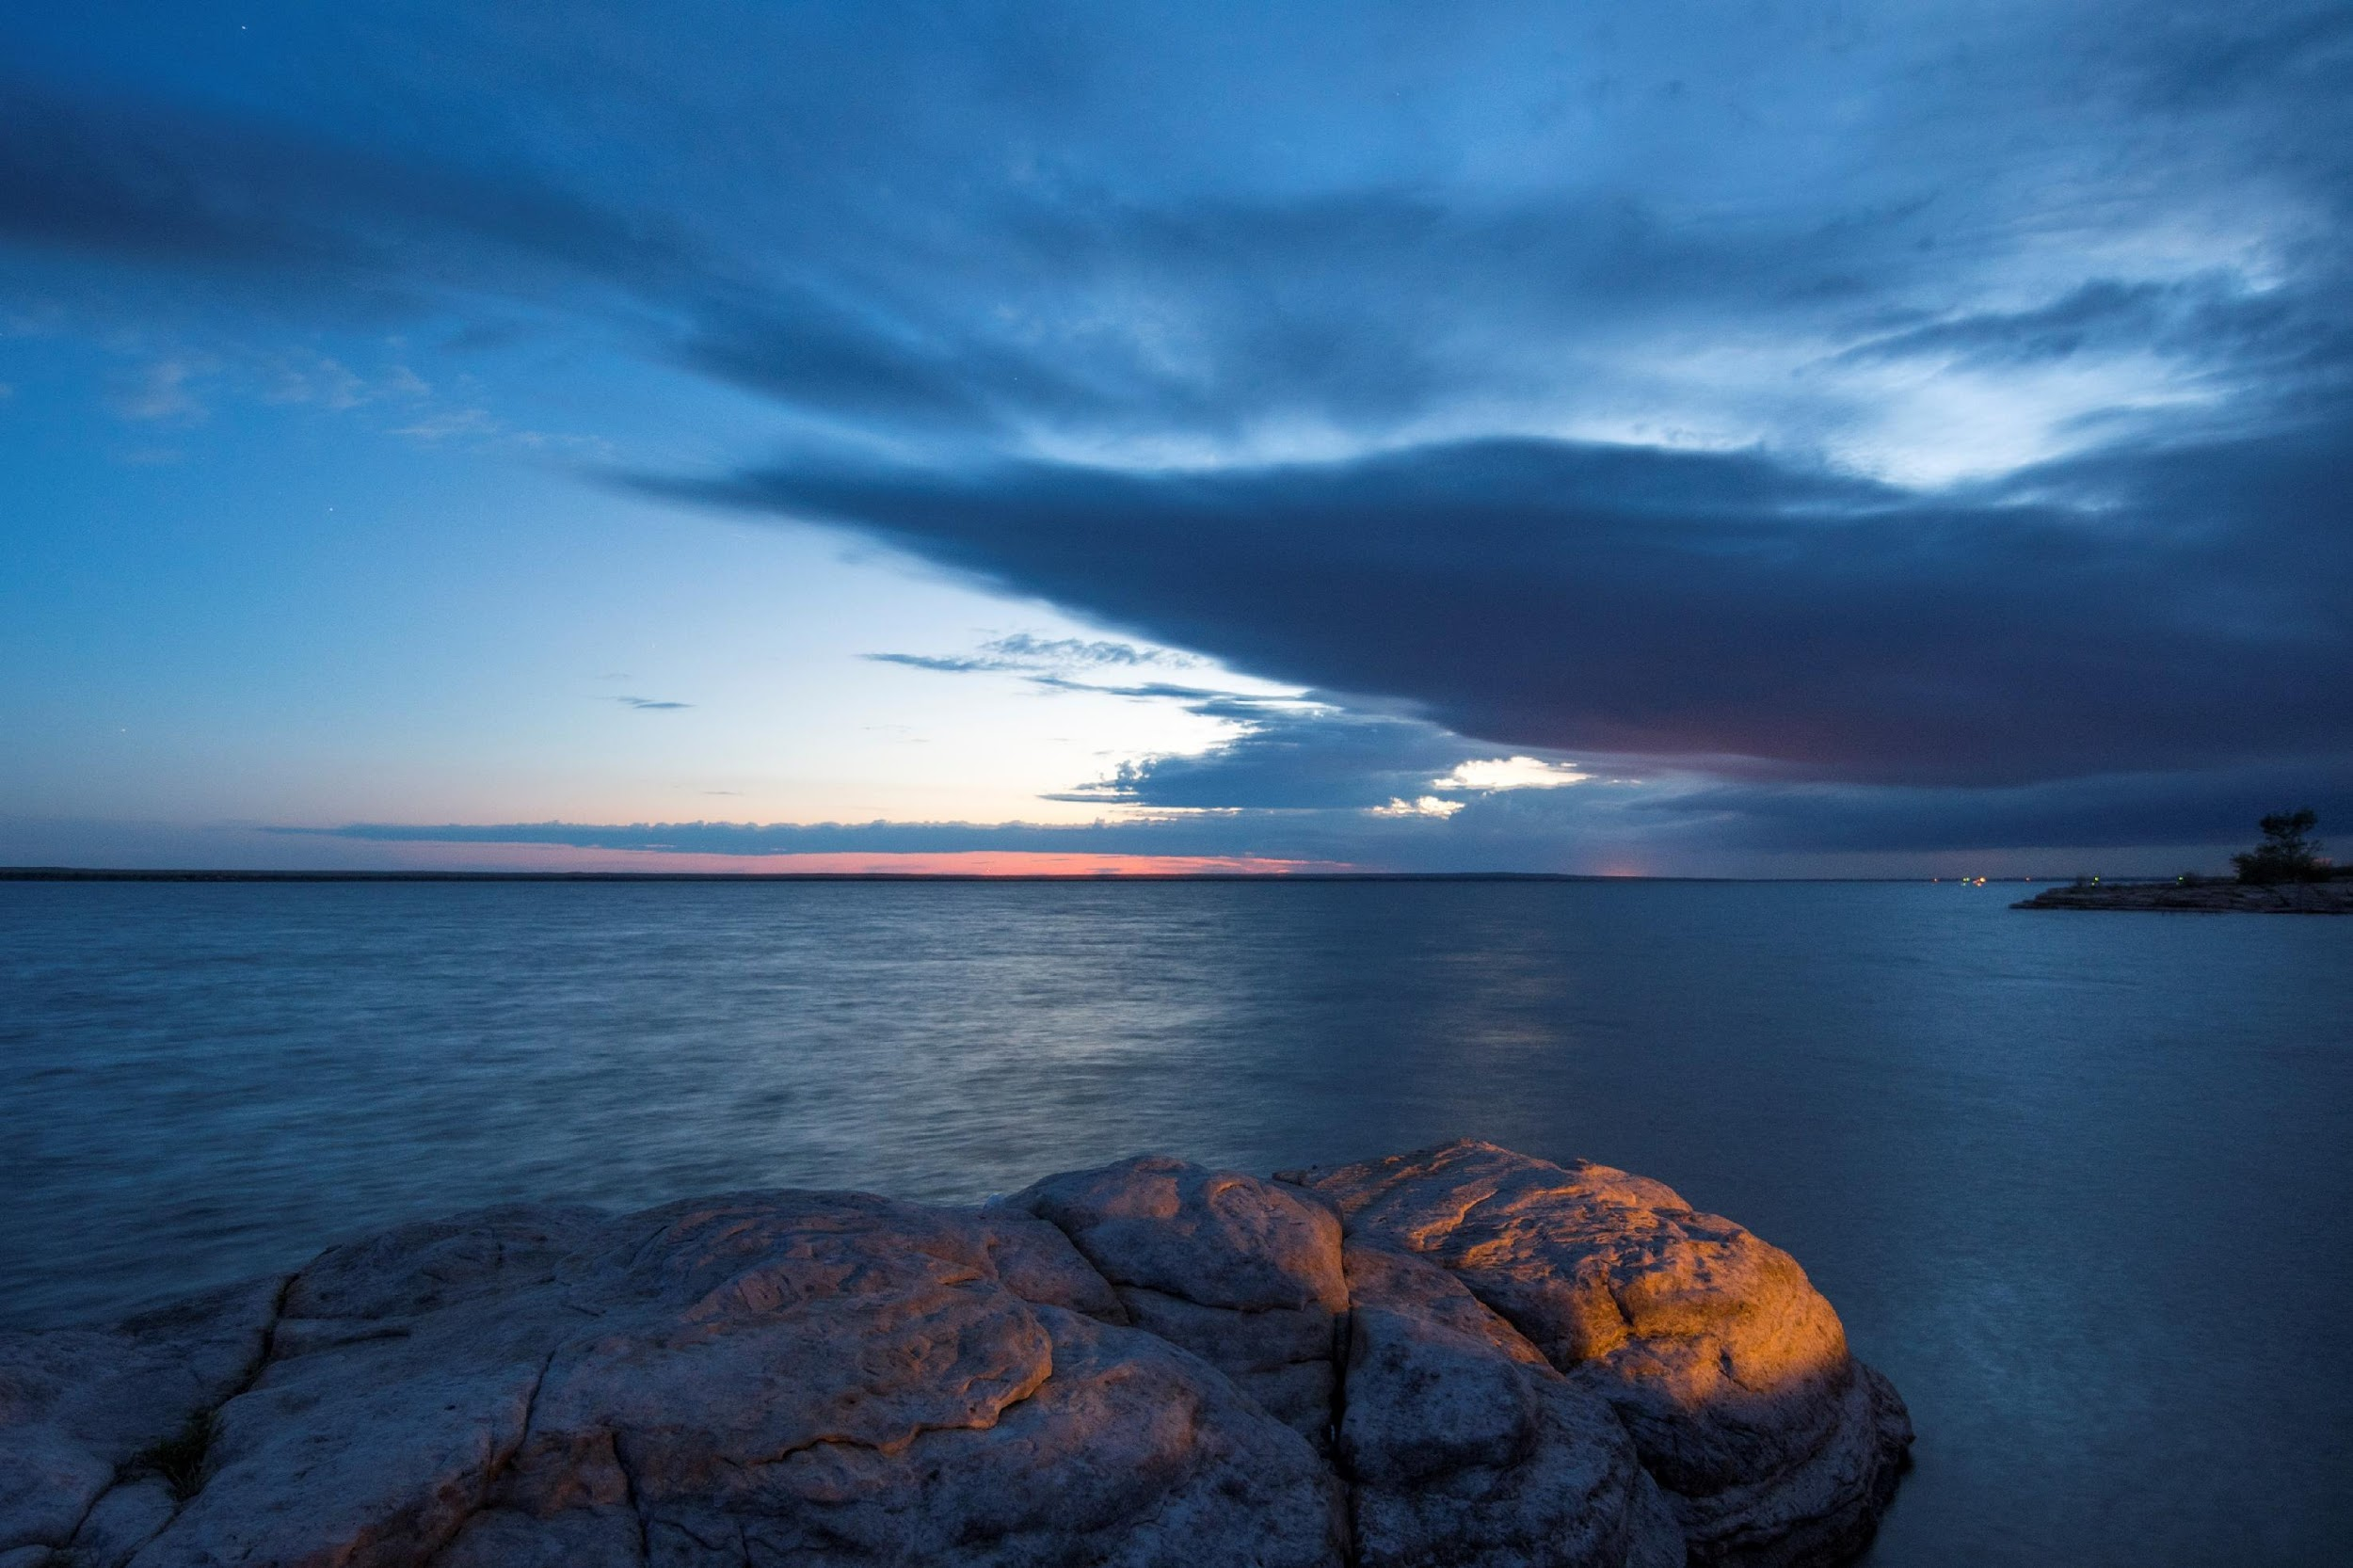
CPW Director’s Innovation Fund
PROJECT NAME | REQUEST | RECOMMENDED AMOUNT | TOTAL BUDGET
Stalker Lake Access Improvement* (NE) | $ 24,155.00 | $ 23,355.00 | $ 86,901.53
Jackson Lake Campsite Beautification* (NE) | $ 25,000.00 | $ 23,818.26 | $ 33,024.10
Yampa River SP Ice Rink (NW) | $ 12,342.99 | $ 12,342.99 | $ 15,532.99
AHRA Rec Ranger Program* (SE) | $ 25,000.00 | $ 23,768.25 | $ 72,600.00
Rifle Gap Dark Skies (NW) | $ 20,739.00 | $ 20,739.00 | $ 28,739.00
Saguache Bear Dumpster Enclosures (SW) | $ 11,746.50 | $ 11,746.50 | $ 23,176.50
Cherry Creek SP Shower Modernization* (NE) | $ 17,568.00 | $ 17,318.00 | $ 19,520.00
Corn Lake ADA Fishing Pier* (NW) | $ 18,112.00 | $ 16,912.00 | $ 25,560.00
TOTALS | $ 154,663.49 | $ 150,000.00 | $ 424,650.91
John Martin Reservoir State Park, Bent County
Notes:
This year’s slate consisted of 12 regional applications (there were no statewide applications) totaling almost $221,000 in requests. With only $150,000 to award, it was a competitive cycle, with a handful of larger requests that covered a really great variety of projects. These are the 8 projects funded by the Review Committee and Director Prenzlow, 5 of which are at partial funding – taking an equitable approach to the overage you see here, and sharing it among multiple projects rather than just one taking the “hit”
Some of this year’s Trends:
There were a few truly innovative projects speaking to underlying needs, embracing the idea of “trying something different to make something better” that have the potential for statewide applicability if successful. It’s ideas like these that are truly critical to the user experience and make Colorado’s state parks and wildlife areas stand out among the rest.
We’ve begun noticing a trend year after year of projects building off previously successful Director’s Innovation Fund recipients.
There was a strong theme of demonstrating CPW & GOCO’s shared values of access and education with multiple projects addressing needed ADA access improvements.
This year also had one compelling project that is the embodiment of the idea of a regional partnership reaching the implementation point of a shared plan to address regional needs. It perfectly aligns with CPW’s newly launched Regional Partnerships program funded in this years Investment Plan and will be a great example of how it all comes together.
Stalker Lake Access Improvement -800 CPW Cash $500
Jackson Lake campsite beautification -1181.74 0
AHRA Rec Ranger Program -1231.75 0
Cherry Creek SP showers -250 $1952
Corn Lake ADA Fishing Pier -1200 0

Slide 10
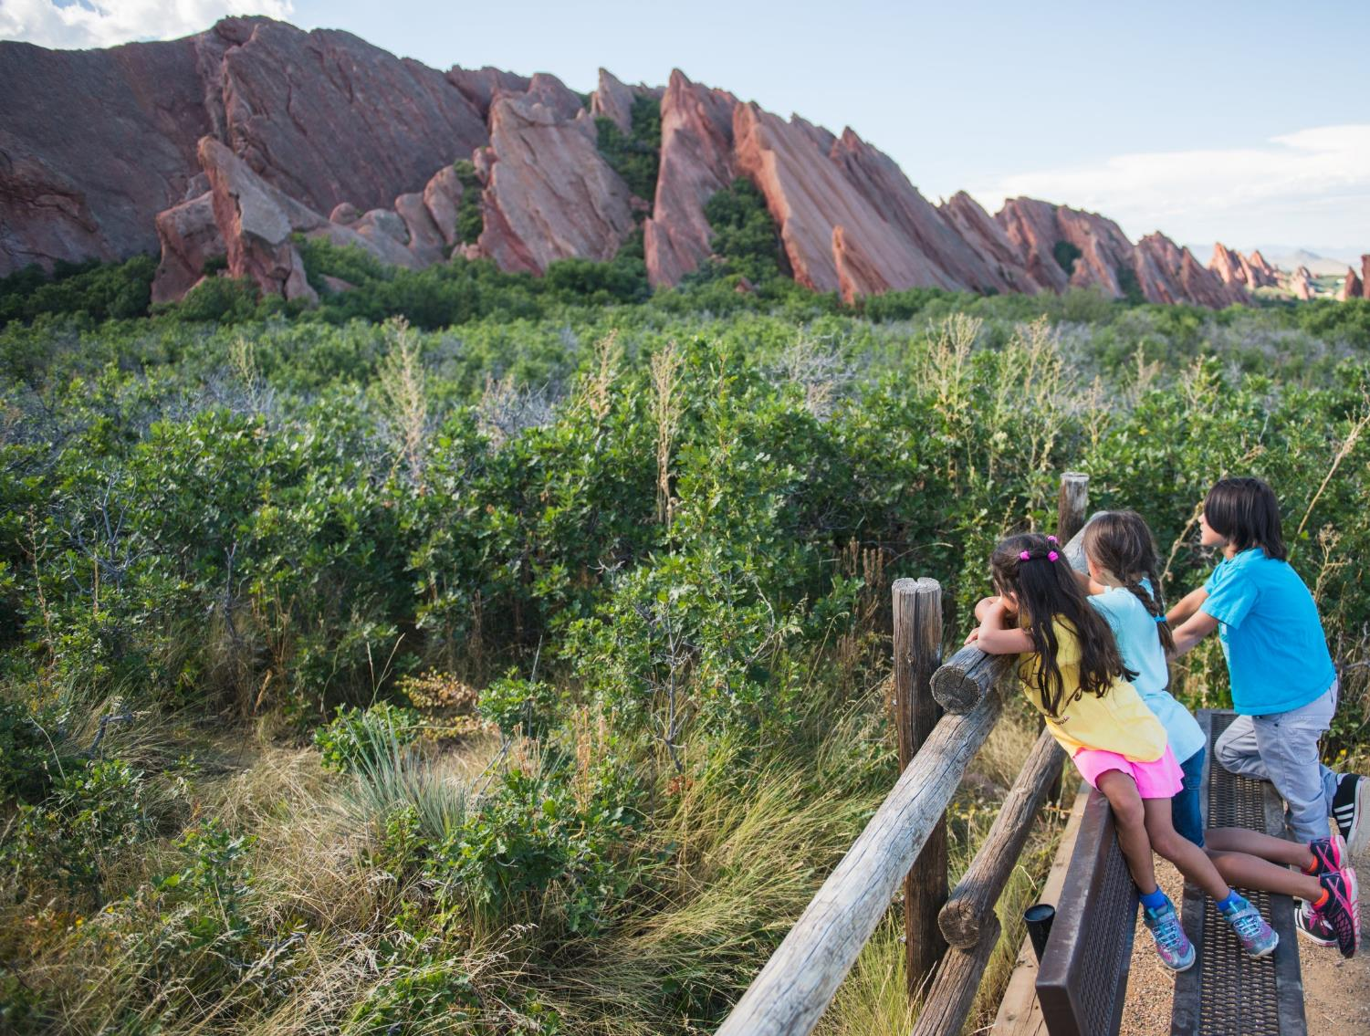
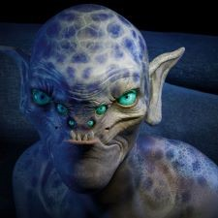
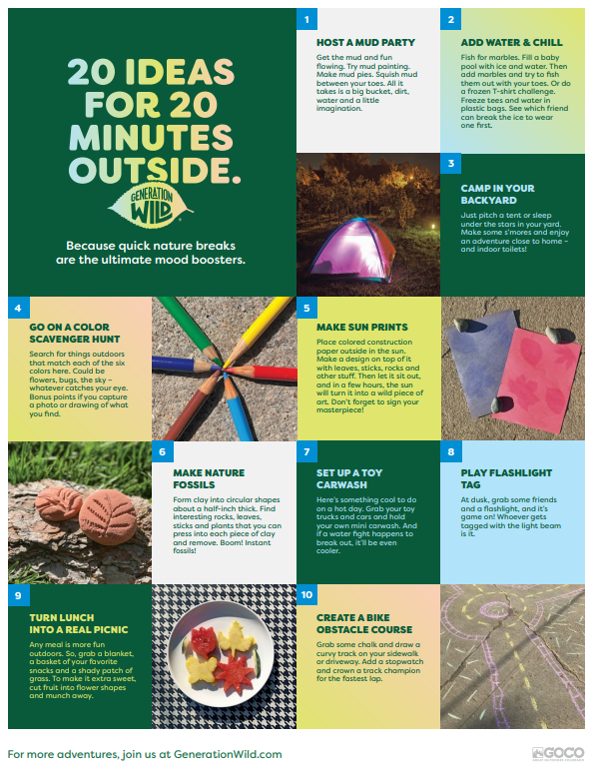
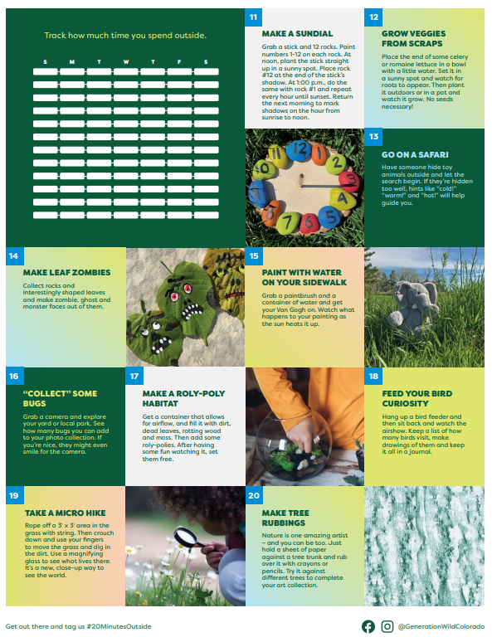
Onward!
Continued Growth & Strategic Plan Implementation
Generation Wild Sumer Campaign
“Just 20 Minutes Outside”
20 Ideas for 20 Minutes Outside List
In-Person in Glenwood Springs in September!!
Roxborough State Park, Littleton
Notes:
To say it’s been a year of transition for GOCO is quite the understatement, but this is truly the culmination of everything we’ve all been working toward for the last 2 years. We will continue to evolve within the structure of our new Strategic Plan, including working with a third party to establish a measurement and evaluation system to track our progress and keep us accountable.
We’re in the middle of our New Generation Wild Summer Campaign, so you’ll likely see some really fun commercials showing the benefits of getting kids outside for at least 20 minutes a day. We’ve also created a “20 Ideas for 20 Minutes Outside List,” a follow up to our very popular “100 things to do before you’re 12” list. If anyone would like hard copies of either of them, I’d be happy to get some sent out.
And lastly, we’re all looking forward to an in-person meeting in September in Glenwood Springs, where of course and as always, you are all more than welcome to attend.

Slide 11
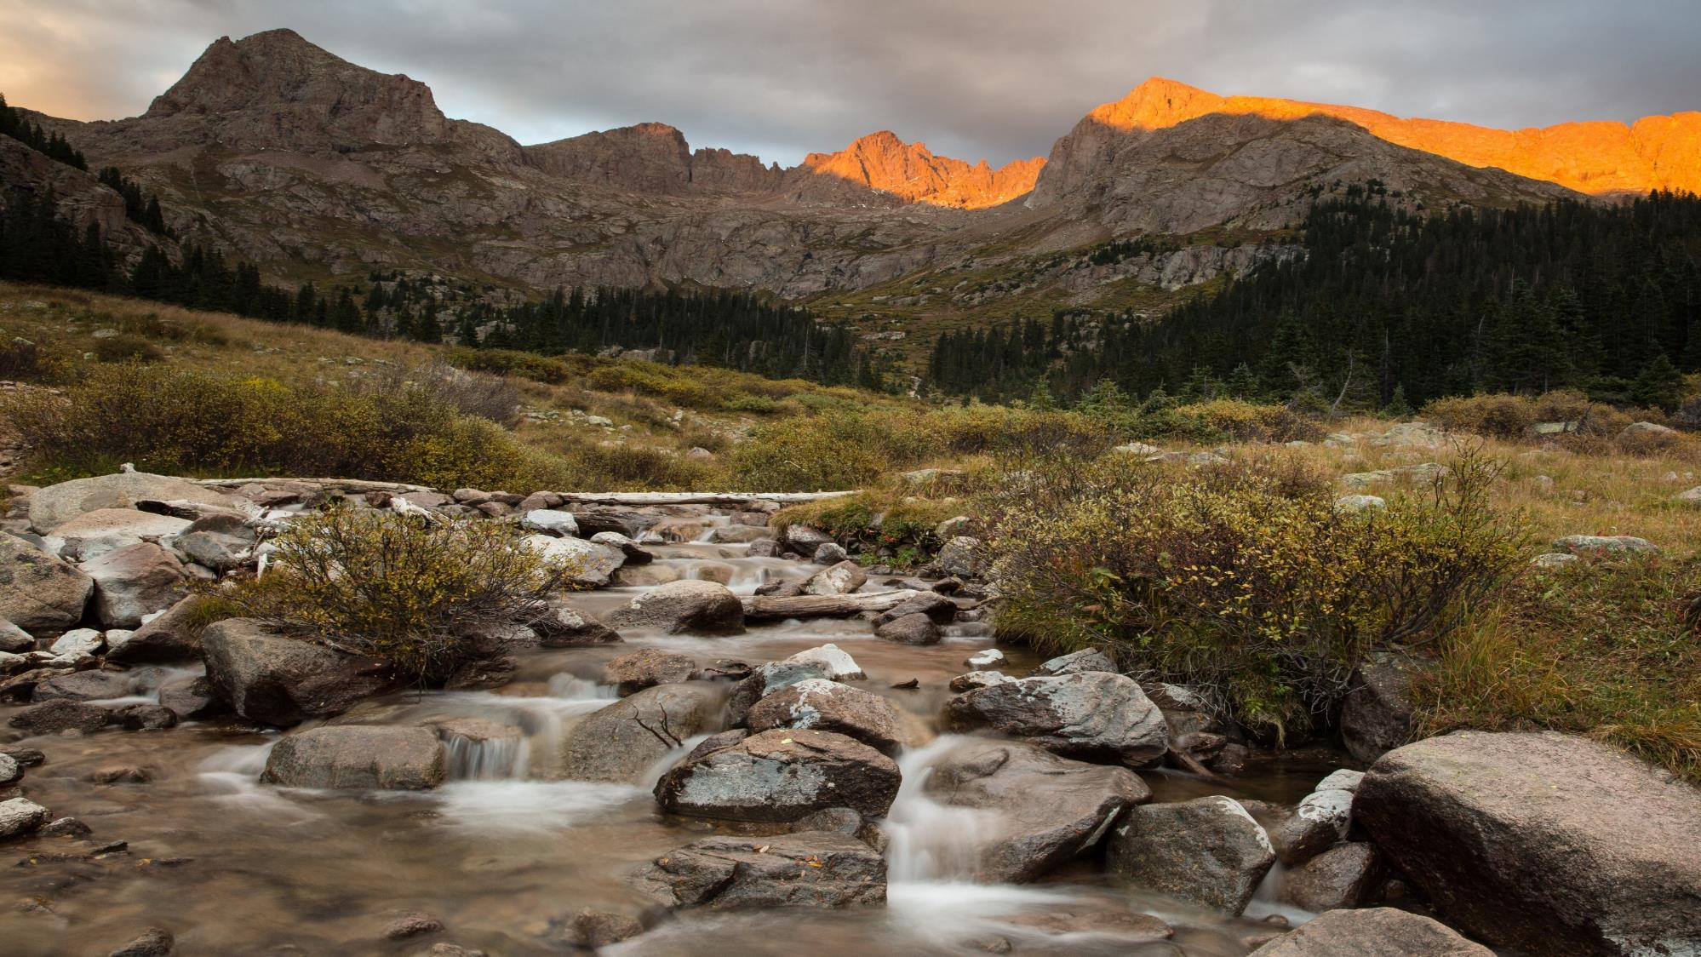
Thank You!
Notes:
And with that, I’ll wrap this up. I am so excited to be back. It is my honor. Thank you very much!

